Slide 1
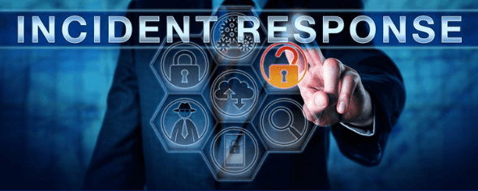
Maven Clinic – Suspicious Activity
Cyber Security Incident Response Plan & Review

Slide 2
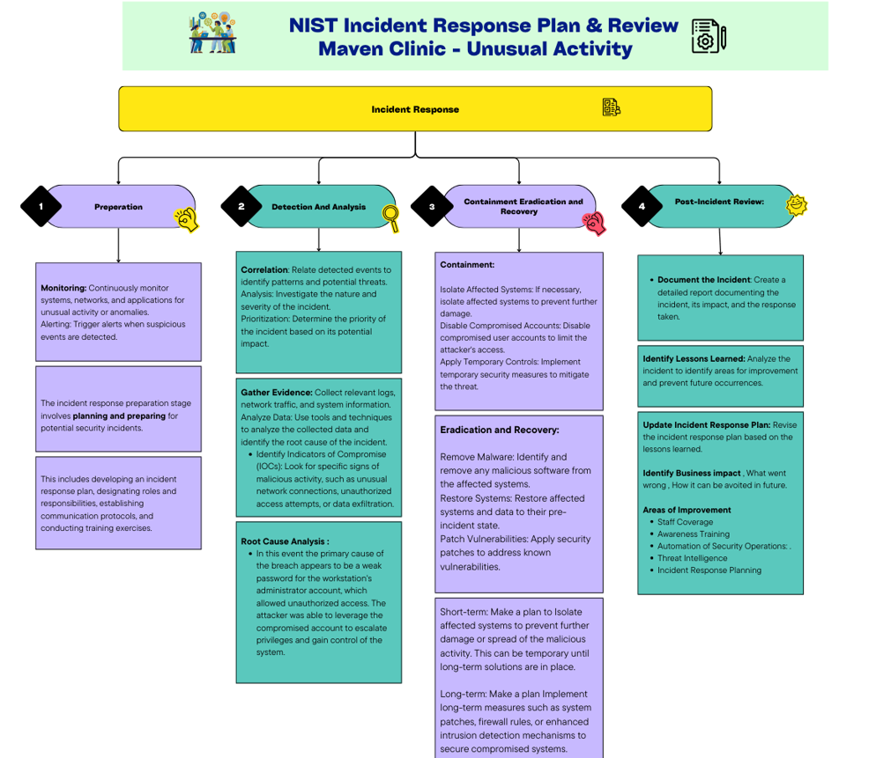

Slide 3
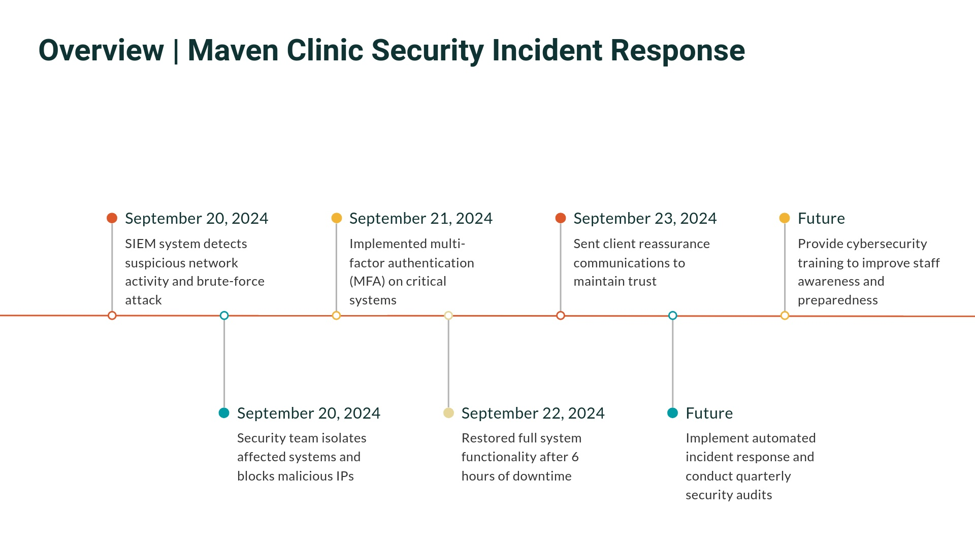

Slide 4
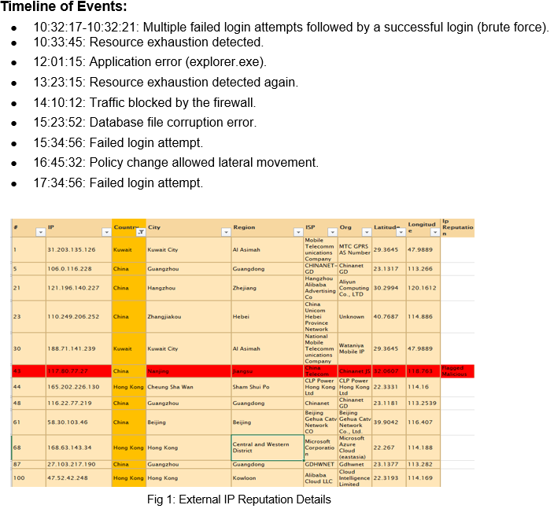

Slide 5
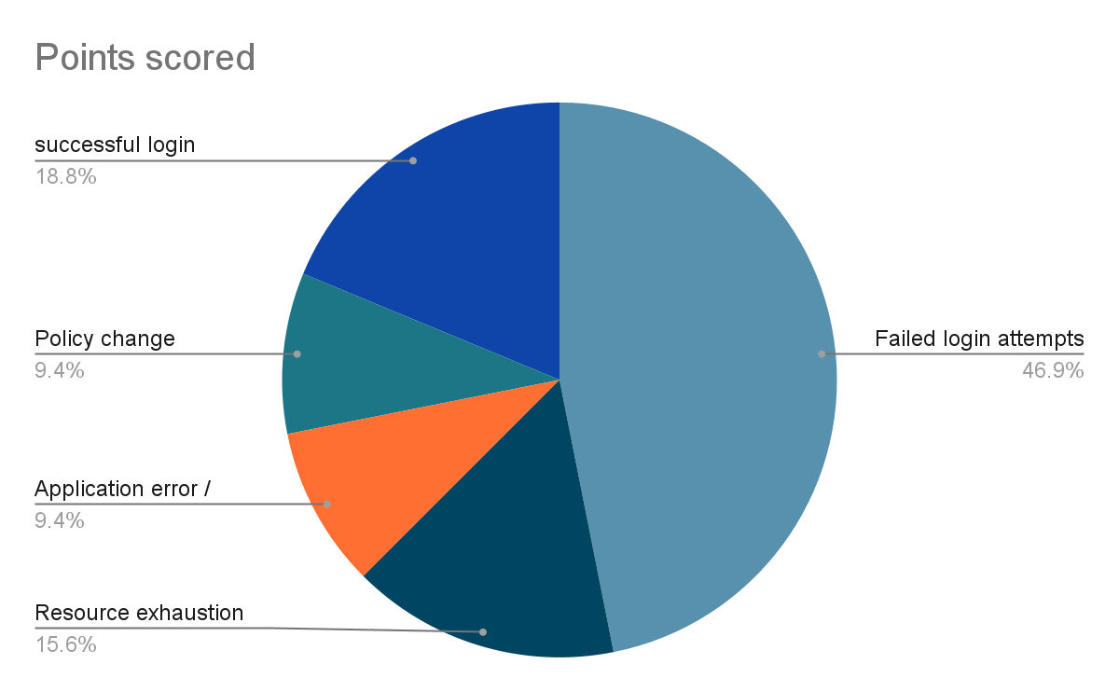
Root Cause Analysis
The primary cause of the breach appears to be a weak password for the workstation's administrator account, which allowed unauthorized access. The attacker was able to leverage the compromised account to escalate privileges and gain control of the system.
On September 20, 2024, Maven Clinic Security Team detected suspicious network activity, including a traffic spike to the external IP address 203.0.113.45 and Multiple failed SSH and RDP login attempts. The activity indicated a brute-force attack targeting sensitive systems and prompted immediate escalation to the security team.
Upon investigation, an unauthorized user account was found accessing sensitive files outside of business hours.
Pie chart displays Event and its occurrence Percentage .

Slide 6
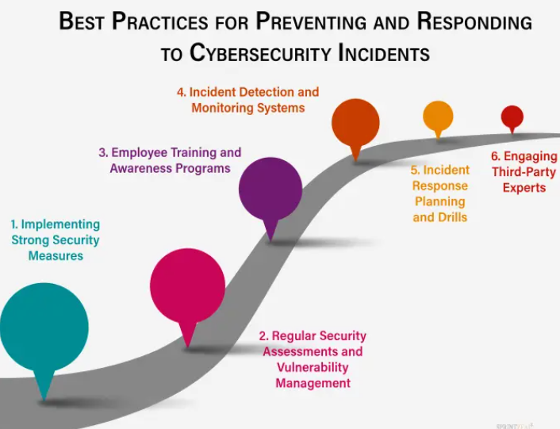
Security Review

Slide 7
Impact to organization
Impact | Effect
Data Exfiltration | Sensitive patient data stored on the workstation may have been compromised.
Disruption of Services | The compromised workstation may have affected the availability of critical services.
Reputational Damage: | A data breach could damage Maven Clinic's reputation and public trust.
Regulation compliance | HIPAA and GDPR must be focused and take steps if any customer data that may have been exposed or compromised.
Downtime | operational disruption or unavailability of data
Customer Impact | Take necessary actions if any sensitive data or PII /health related data exposed

Slide 8
Communication Plan
Key Stakeholders:
Stakeholders and the team must be quickly notified about the incident.
IT Department: All members of the IT team, including system administrator, network engineers must be notified and take necessary steps to closely monitor the network.
Executives: C-level executives, board members, and other key decision-makers.
Affected Users: Employees, customers, or partners who may be impacted by the incident.This case Host machine DESKTOP-1234567 and user John doe must be notified , the file or server owner must be informed about the incident.
External Parties: Law enforcement, regulatory agencies, or other third parties as needed.In case of data breach of sensitive information that involves other parties must be communicated directly.

Slide 9
Lessons Learned
Importance of Strong Passwords: The breach highlights the critical importance of using strong, unique passwords for all accounts.
Regular Security Assessments: Regular vulnerability assessments are essential for identifying and addressing potential risks.
Employee Education: Security awareness training can help employees recognize and prevent phishing attacks.
Incident Response Planning: A well-defined incident response plan can help organizations respond effectively to security incidents.
Conduct a Post-Incident Review: Analyze the incident to identify lessons learned and areas for improvement.
Implement Preventive Measures: Strengthen security measures to prevent similar incidents in the future

Slide 10
Preventive Measures
Phishing Awareness Training
Strong Password Policies( complex with MFA)
Regular Security Assessments
Incident Response Planning
Data Encryption
Strong Access Controls to limit sensitive data access
Third-Party Risk Management

